Slide 1







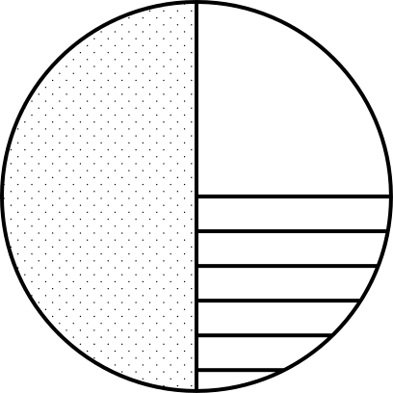
Nhóm 4
Unit 4: Administration

Slide 2
The list of members in team 4
Huỳnh Tuấn Minh - MSSV: 6151071072
Trần Văn Quang - MSSV: 6151071086
Nguyễn Hữu Tri - MSSV: 6151071106
Hoàng Xuân Tùng - MSSV: 6151071029
Mai Thanh Nam - MSSV: 5751071025
Nguyễn Văn Mạnh - MSSV: 6151071070

Slide 3

Vocabulary

Slide 4
Vocabulary
Administration /ədˌmɪnɪˈstreɪʃn/: the management of public affairs.
Spreadsheet /ˈspredʃiːt/: a computer program that is used, for example, when doing financial or project planning. You enter data in rows and columns and the program calculates.
Formula /ˈfɔːrmjələ/: Formula is used especially in scientific language.
Cell /sel/: ​one of the small squares in a spreadsheet computer program in which you enter a single piece of data.

Slide 5
Vocabulary
Column /ˈkɑːləm/: one of the straight sections from top to bottom into which text on a page or screen is divided.
Row /rəʊ/: a line of numbers or words arranged one after the other across the page in a table.
Multifunction printer: a printer that also has other functions such as scanning, copying and/or faxing.
Sum /sʌm/: sum (of something) the number you get when you add two or more numbers together. (+)

Slide 6
Vocabulary
Subtract /səbˈtrækt/: to take a number or an amount away from another number or amount. (-)
Multiply /ˈmʌltɪplaɪ/: to add a number to itself a particular number of times. (x)
Divide /dɪˈvaɪd/: to separate into parts; to make something separate into parts. (/)
Equal /ˈiːkwəl/: the same in size, quantity, value, etc. as something else. (=)

Slide 7
Vocabulary
Query /ˈkwɪri/: a question, especially one asking for information or expressing a doubt about something.
Retrieve /rɪˈtriːv/: to bring or get something back, especially from a place where it should not be.
Peripherals /pəˈrɪfərəl/: (of equipment) connected to a computer.

Slide 8
GRAMMAR
ALTHOUGH/DESPITE…

Slide 9
GRAMMAR
Part 1:
Although/ Though/ Even though + clause 1 +, clause 2
EX: Though she had a headache, she went to work.
Clause 1 ,+ Although/ Though/ Even though + clause 2
EX: She went to work, though she had a headache.
Despite/ In spite of + noun/ noun phrase/ Ving +, clause
EX: Despite her headache, she went to work.
Clause + Despite/ In spite of + noun/ noun phrase/ Ving
EX: She went to work despite her headache.

Slide 10
GRAMMAR
Part 2:
+ Change the sentence pattern using Although to Despite and vice versa
Case 1: The Subject of the two clauses in the sentences are the same
Although/ Though/ Even though + S + V + O
-> Despite/ In spite of + Ving + O
EX: Although David lives near the company, he always goes to work late.
-> Despite living near the company, David always goes to work late.

Slide 11
GRAMMAR
Case 2: If Although/ Though/ Even though has form there + be + noun/ noun phrase
Although/ Though/ Even though + there + be + noun/ noun phrase
-> Despite/ In spite of + noun/ noun phrase
EX: Although there is a problem with my lifestyle, I’m still healthy.
-> Despite a problem with my lifestyle, I’m still healthy.

Slide 12
GRAMMAR
Case 3: If Although/ Though/ Even though has form (I, we, you, he, she, it, they)/ noun/ noun phrase + be + adj
Although/ Though/ Even though + N + be + adj
-> Despite/ In spite of + my/our/your/his/her/its/their + noun/ noun phrase
EX: Although she is unfriendly, they like her.
-> Despite her unfriendliness, they like her.

Slide 13
GRAMMAR
Case 4: If Although/ Though/ Even though has form it + be + adj
Although/ Though/ Even though + it + be + adj
-> Despite/ In spite of + noun/ noun phrase
EX: Yesterday, we went to the zoo, though it was rainy.
-> Yesterday, we went to the zoo despite the rain.

Slide 14
GRAMMAR
REWRITE THESE SENTENCES, USING ALTHOUGH/DESPITE…
1. Despite its leading international provider of computer hardware, Fuchiba company doesn’t earn more profit than its competitors.
_ Although Fuchiba company is a leading international provider of computer hardware, Fuchiba company doesn’t earn more profit than its competitors.
2. In spite of having our service centre in all our major markets, we can’t provide a very high level of customer service.
_ Though we have our service centre in all our major markets, we can’t provide a very high level of customer service.

Slide 15
GRAMMAR
3. This award-winning games can also be played on the mobile phone operating systems although they aren’t produced for that purpose.
_ Despite not being produced for that purpose, this award-winning games can also be played on the mobile phone operating systems
4. Although he is the old staff at XBM Digital, he has no idea about the company rules for security.
_ Despite being the old staff at XBM Digital, he has no idea about the company rules for security.
5. We can hire a new technician in spite of cutting costs at the moment.
_ Although we cut costs at the moment, we can hire a new technician

Slide 16



1
2
Table
Spreadsheets and formulae
Databases
of contents
3
4
Systems administration
Peripherals

Slide 17



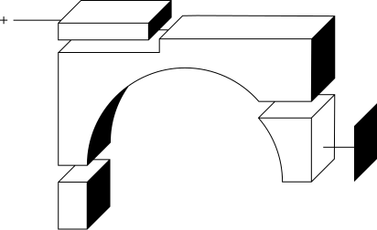
Spreadsheets and
formulae

Slide 18
Page 28 - Vocabulary 2 : Work in pairs. Match sentences 1-4 to sums a-d .Then rewrite the sentences using the words in brackets.
1 If we divide 8 by 2 , we get 4. (divided by)
a) 8 + 2 =
8 plus 2 is 10
2 If we subtract 2 from 8 , we get 6. (minus)
b) 8 – 2 =
8 minus 2 is 6
3 If we multiply 8 by 2 , we get 16. (times)
c) 8 / 2 =
8 divided by 2 is 4
4 The sum of 8 and 2 is 10. (plus)
d) 8 x 2 =
8 times 2 is 16

Slide 19

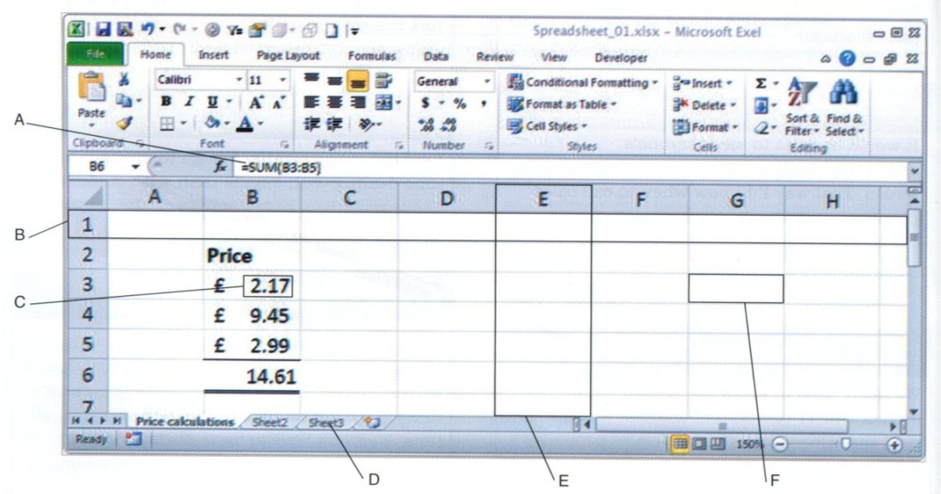
Page 28 - Listening 4 :Listen to a trainer explaining a formula in this spreadsheet. Match these words to A-F in the spreadsheet. What does the formula do?
The formula adds up some numbers.
1 cell_______
3 formula_______
5 value_______
F
A
C
2 column_______
4 row_______
6 worksheet_______
E
B
D

Slide 20
Page 29 - Listening 7 : Listen to four employees explaining their problems with spreadsheets. Complete this table.
Action | Problem
1 typed in formula
Get an error message
2 saved a spreadsheet (in the main folder)
can’t find it
3 designed a spreadsheet
it doesn’t work
4 typed a date (into a cell)
it shows a number (instead)

Slide 21
Databases

Slide 22
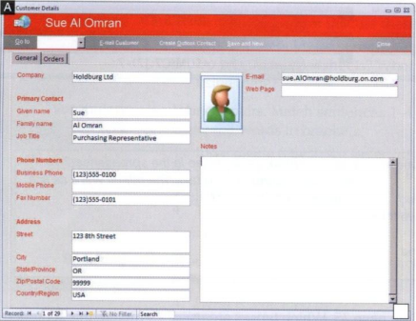
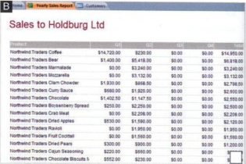
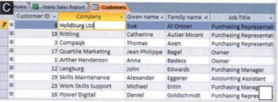
Listening
Task 2: Listen to a database administrator describing the structure of a company database to a trainee. Match these words to screenshots A-C.
1. Report
2. Table
3. Form
Form
Report
Table

Slide 23
Listening
Task 3: Listen again. Which option best describes what the database keeps track of?
a) Clients and orders
b) Stock and orders
c) Orders and full accounts

Slide 24
Vocabulary
Task 4: Complete this manual with the words in the box. Then read audio script 19 on page 75 and check your answers.
1.
object
5.
primary key
2.
record
6.
form
3.
fields
7.
report
4.
unique
8.
retrieve a record
9.
query the database

Slide 25
Systems
administration

Slide 26
Vocabulary
Task 5. Find words in the table in 4 that match these definitions.
reset
1. change; set again
2. install on many computers at the same time
3. settings on a computer, file or folder that say who can use it
4. data that a program or computer produces while it runs, to show how well it is working
deploy
permissions
logs

Slide 27
Vocabulary
Task 6. Complete these collocations and phrasal verbs from the conversation in 3 with the words in the box.
crash out out of running again smoothly (x2)
smoothly
out of
1. run
2. disk
3. be up and
4. lock (someone) (something)
5. check (something)
6. go
crash
out
running again
smoothly

Slide 28
Vocabulary
Task 7. Use these prompts to write sentences with while, before or after
1. install an operating system/the computer may reboot several times
2. deploy major software upgrades/train the users
While you install/While installing an operating system, the computer may reboot several times
Before you deploy/Before deploying major software upgrades, (you need/have to) train the users

Slide 29
Vocabulary
Task 7. Use these prompts to write sentences with while, before or after
3. replace the hard drive/everything will go smoothly
4. forget a password/reset it
After you replace/After replacing the hard drive, everything will go smoothly
After someone forgets a password, (you need/have to) reset it

Slide 30
Peripherals

Slide 31
Vocabulary
Task 2. Match photos A-H to definitions 1-8
1. NAS (network attached storage) device: a collection of drives in a single box, accessed through a network and thus more flexible than a device attached to only one computer.
2. touchpad: part of a laptop computer used instead of a mouse for moving the cursor.
3. stylus: a pen-shaped device sometimes used with some kinds of screens.
4. graphics tablet and stylus: a flat pressure-sensitive pad and pen-shaped device, often used with graphic design software.

Slide 32
Vocabulary
Task 2. Match photos A-H to definitions 1-8
5. touch screen: a screen that can detect when and where a finger touches it.
6. projector: a device that shows a copy of the computer’s screen on a large screen, often used in presentations.
7. headset: a device people wear on their heads that includes a microphone as well as headphones.
8. multifunction printer: a printer that also has other functions such as scanning, copying and/or faxing.

Slide 33
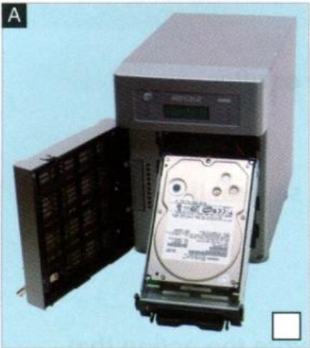
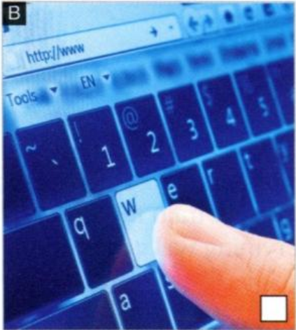
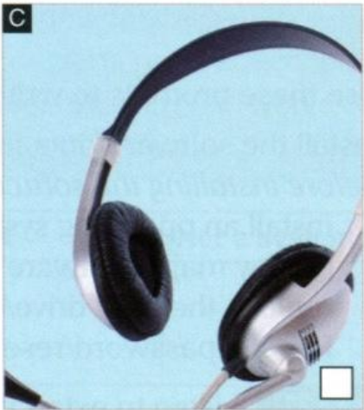
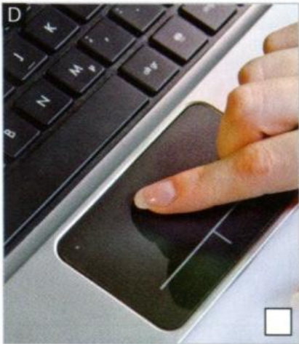
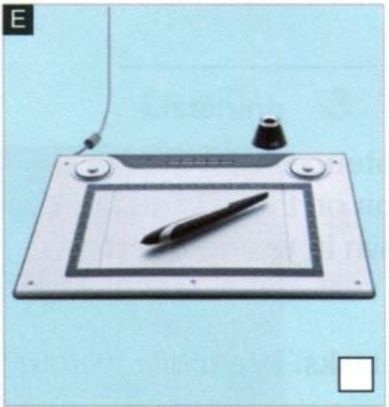
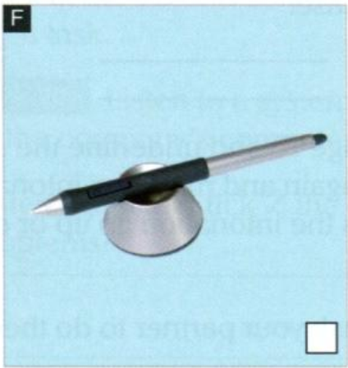
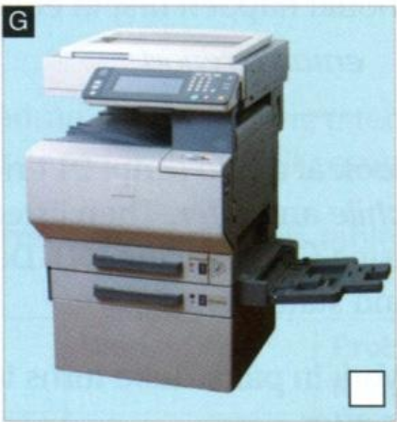
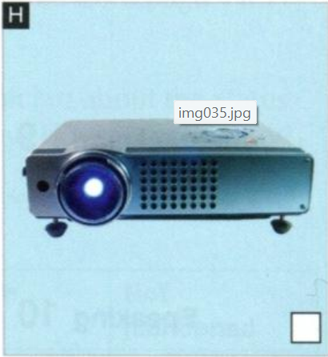
Task 2. Match photos A-H to definitions 1-8
1. NAS device
5. touch screen
7. headset
2. touchpad
4. graphics tablet and stylus
8. multifunction printer
3. stylus
6. projector

Slide 34
Vocabulary
Task 3. Write/next to the input devices and O next to the output devices in 2. Which devices are both? Which device is neither?
1. NAS (network attached storage) device: a collection of drives in a single box, accessed through a network and thus more flexible than a device attached to only one computer._______
2. touchpad: part of a laptop computer used instead of a mouse for moving the cursor.______
3. stylus: a pen-shaped device sometimes used with some kinds of screens._____
4. graphics tablet and stylus: a flat pressure-sensitive pad and pen-shaped device, often used with graphic design software.________
neither
I
I
I

Slide 35
Vocabulary
Task 3. Write/next to the input devices and O next to the output devices in 2. Which devices are both? Which device is neither?
5. touch screen: a screen that can detect when and where a finger touches it.____
6. projector: a device that shows a copy of the computer’s screen on a large screen, often used in presentations.______
7. headset: a device people wear on their heads that includes a microphone as well as headphones.______
8. multifunction printer: a printer that also has other functions such as scanning, copying and/or faxing.______
I, O
O
I, O
O

Slide 36
Listening
Task 4. Listen to an assistant systems administrator explaining a problem to his manager and complete this table.
Action in progress
The accountant __________to save a spreadsheet to the NAS device.
Problems 1 ____________________________________ 2 ____________________________________ 3 ____________________________________
was trying
got an error message
couldn’t connect to it (from anywhere)
maybe a problem with the network cable

Slide 37
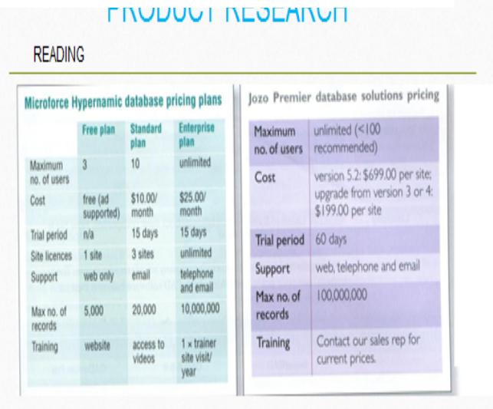
SPEAKING PART 2
No 4: Compare the two pricing Plans
I will talk about the topic named compare the two pricing plans below.
The first photo on the left shows the Microforce Hypernamic database pricing plans.
In the second picture, It is called the Jozo Premier database solutions pricing.
Two pricing plans have the same maximum no of users is unlimited..
The cost on the right picture is more expensive than
The cost on the left picture.

Slide 38
SPEAKING PART 2
No 4: Compare the two pricing Plans
The trial period on the right photo is longer than the other.
The support on the purple pricing plan have more choices than the green ones.
The Max no of records on the right plan is about 100,000,000 and it is about ten times the max no of records on the left plan.
After all, the training on the purple plan is more convenient for people, because we can call by phone number or meet the trainer. The training on the green plan just let us contact trainer site visit if we have problem.

Slide 39
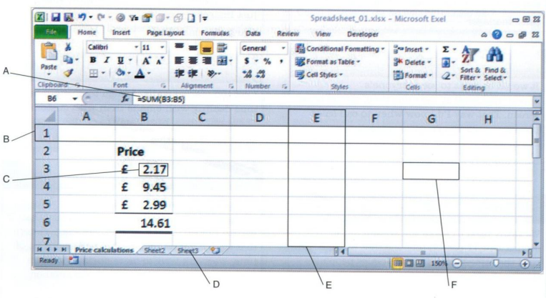
SPEAKING PART 2
No 5: Talk about A, B, C, D, E, F in this spreadsheet
In this section I will introduce to you some properties of the spreadsheet.
And will talk about the Formula, Value, Column, Row, Cell and WorkSheet.
Let's start with Formula, this is where we get the value from the cell to calculate. The value can be number, text, date, time,.. and it is stored in the cell.
Next, A row is a horizontal series of cells and A column, on the other hand, is a vertical series of cells that share the same letter at the top of the column.
And the last one is worksheet, worksheet is a single tab within a spreadsheet file that contains a grid of cells.

Slide 40
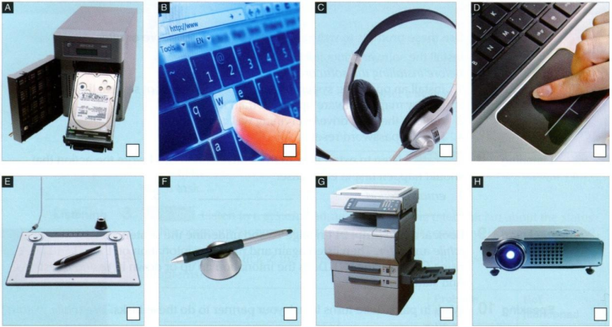
SPEAKING PART 2
No 6: Talk about this peripherals
I will talk about this peripherals.
A is a NAS device (network attached storage) is a collection of drives in a single box that can be accessed through a network and allows multiple users to access and share data.
B is a touchscreen is one that can detect when and where a finger touches it.
C is a headset is a device that people wear on their head to hear and speak
D is a trackpad is a part of a laptop that is used in place of a mouse to move the pointer.

Slide 41
SPEAKING PART 2
No 6: Talk about this peripherals
E is a graphics tablet and stylus is a pen-shaped device and a flat force-sensitive pad commonly used with graphic design software. It allows designers to create digital art and graphics more easily and efficiently.
F is a stylus is a pen-shaped device that allows the user to interact with the touch screen.
G is a multifunction printer is a printer that has other functions such as scanning, copying and/or faxing.
Finally, H is a projector is a device that displays your presentations.

Slide 42

QUESTION FOR IT SPEAKING TEST
What is the largest unit of storage in a computer?
It is a terabyte. The terabyte is about 1 thousand billion bytes and it is about 1 thousand GB.
How to connect a laptop to a projector?
First, switch on both the laptop and the projector.
Second, connect the HDMI cable to the laptop’ HDMI port and connect the other end to the projector.
Finally, if the presentation won`t display on the projector , you need to press the combination Ctrl+ F5.

Slide 43
QUESTION FOR IT SPEAKING TEST
Why do we back up data?
Backups data to save data and protect against human errors, virus attacks. Backups can help save time and money if these failures occur.

Slide 44
Thank you
See you next time!

